Slide 1

STOCK PREDICTION USING DEEP LEARNING AND SENTIMENTAL ANALYSIS
Under Guidance of Prof. Prajakta Soman

Slide 2
Team Members
Piyush Ramesh Datir 1132200500
Aditya Gajanan Dorwekar 1132200246
Aditya Digambar Joshi 1132200230
Aniket Ratnakar Pawar 1132200111
Karan Uday Bhelkar 1132200658
Ashutosh Bhagwant Pangaonkar 1132200157

Slide 3
Index
Motivation
Objectives
Literature Survey
Project Plan
Problem Statement
System Architecture
Data Flow Diagram
Use case Diagram
Hardware Requirements
Software Requirements
Future Scope
Conclusion
Result

Slide 4
Motivation
Country was in lockdown for months due to the pandemic.
It Created issues like unemployment.
To develop a Stock price prediction Model using DL.
To reduce human efforts
Hence to Maintain the financial income using stock market.
In order to do so, our aim is to help people in stock market related decision.

Slide 5
OBJECTIVES
To develop a Stock price prediction Model using ML
To reduce human efforts.
To ensure that the accuracy will be higher.
To ensure that GUI will be User friendly.

Slide 6
Problem Statement
We propose a method for stock prediction based on a set of technical trading rules, which are optimized by a optimization algorithm. The aim of the research is to check if it is possible to obtain a set of trading rules deriving from technical indicators and Sentiments of people in market, which could be used to take decisions such as Buy, Wait or Sell

Slide 7
Project Plan
We are develop a system which can predict the stock price.
By using the previse data of that stock from the yfinance
And for sentimental anlysis , we are fetching it from Twitter API.
for prediction we are using LSTM algorithm

Slide 8
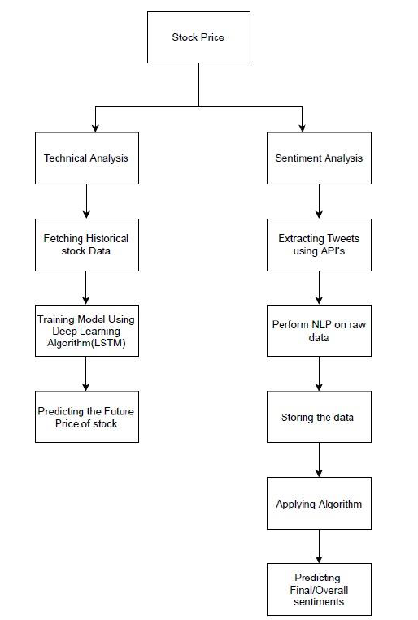
System Architecture

Slide 9
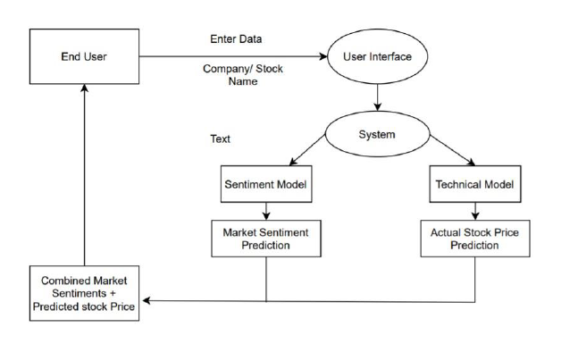
Data Flow Diagram

Slide 10
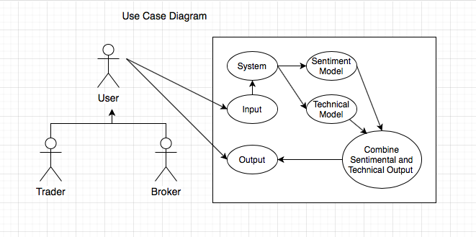
Use case Diagram

Slide 11
Hardware Requirements
System with 8GB RAM, INTEL i5 / Ryzen 5 processor
GPU for training the model

Slide 12

Technology Stack
Tiingo & Twitter API
Platform used:- Jupytor Notebook, idle.
Language : Python
System Requirement-Windows OS, Ubuntu.
Libraries Used : Numpy, Pandas, Sklearn, Matplotlib, Keras, NLTK

Slide 13
Future scope
This project is the initial phase of development where the algorithms are selected and are being developed.
As we proceed further the algorithm will be optimized for more technical parameters and more complex parameters, to get much more real world output values.
We have considered only twitter data for analysing people’s sentiments which may be biased because not all the people who trade share their opinions on Twitter. The study can be extended by incorporating data from various platforms like moneycontrol.com, stock twits, Yahoo Finance, etc.

Slide 14
Conclusion
The proposed system will help beginner traders as a decision support tool and help them take decisions accordingly.
Collective analysis of news regarding market have been made easy using machine learning algorithms

Slide 15
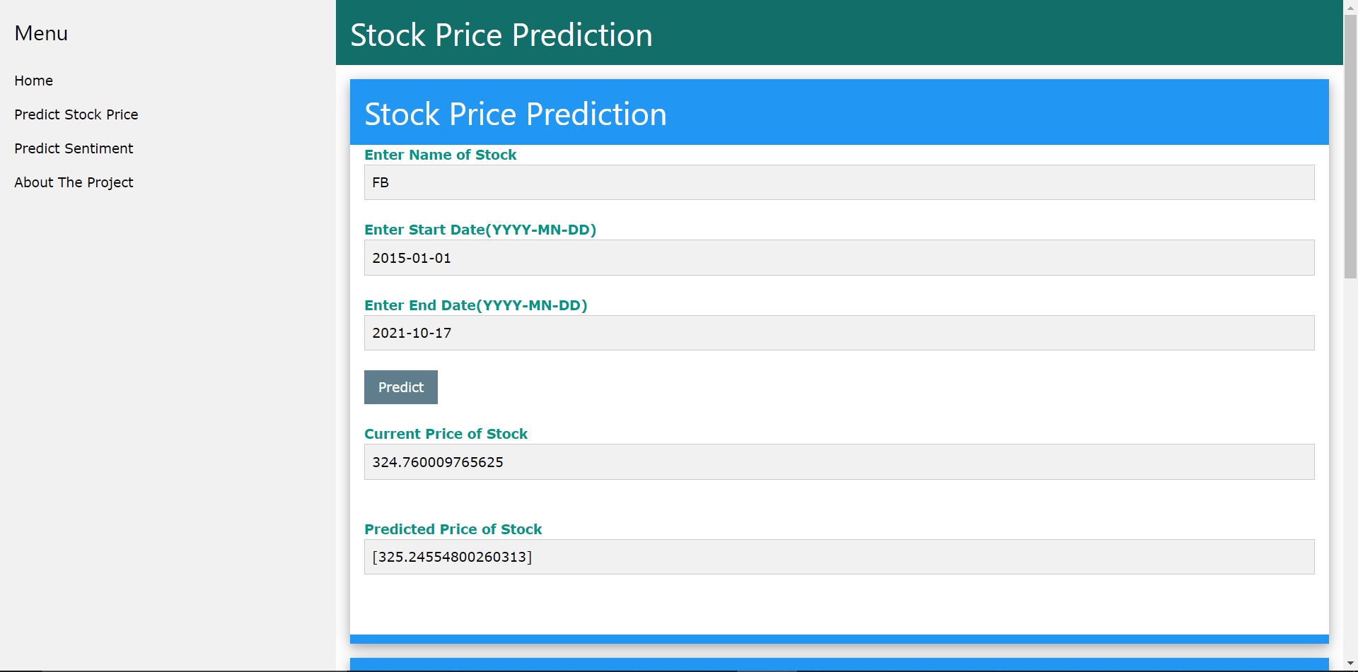
Results:

Slide 16
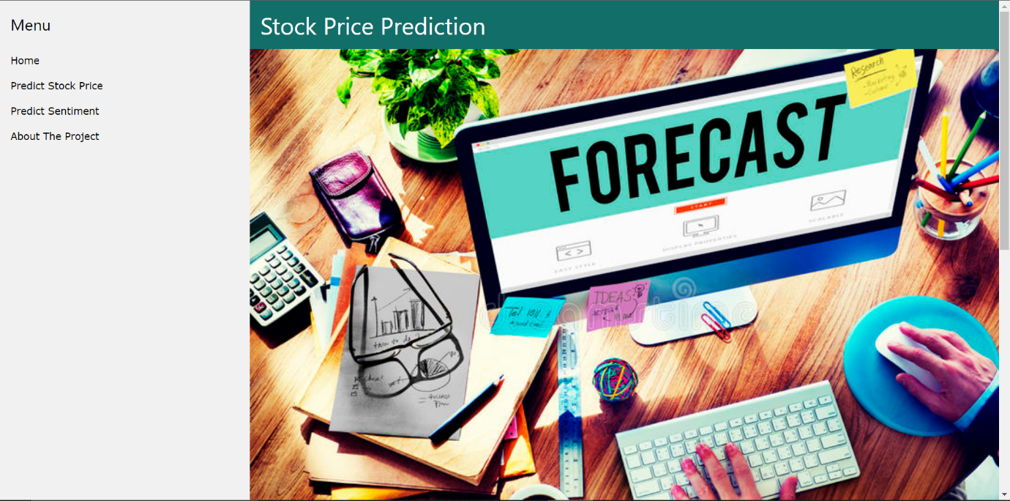

Slide 17
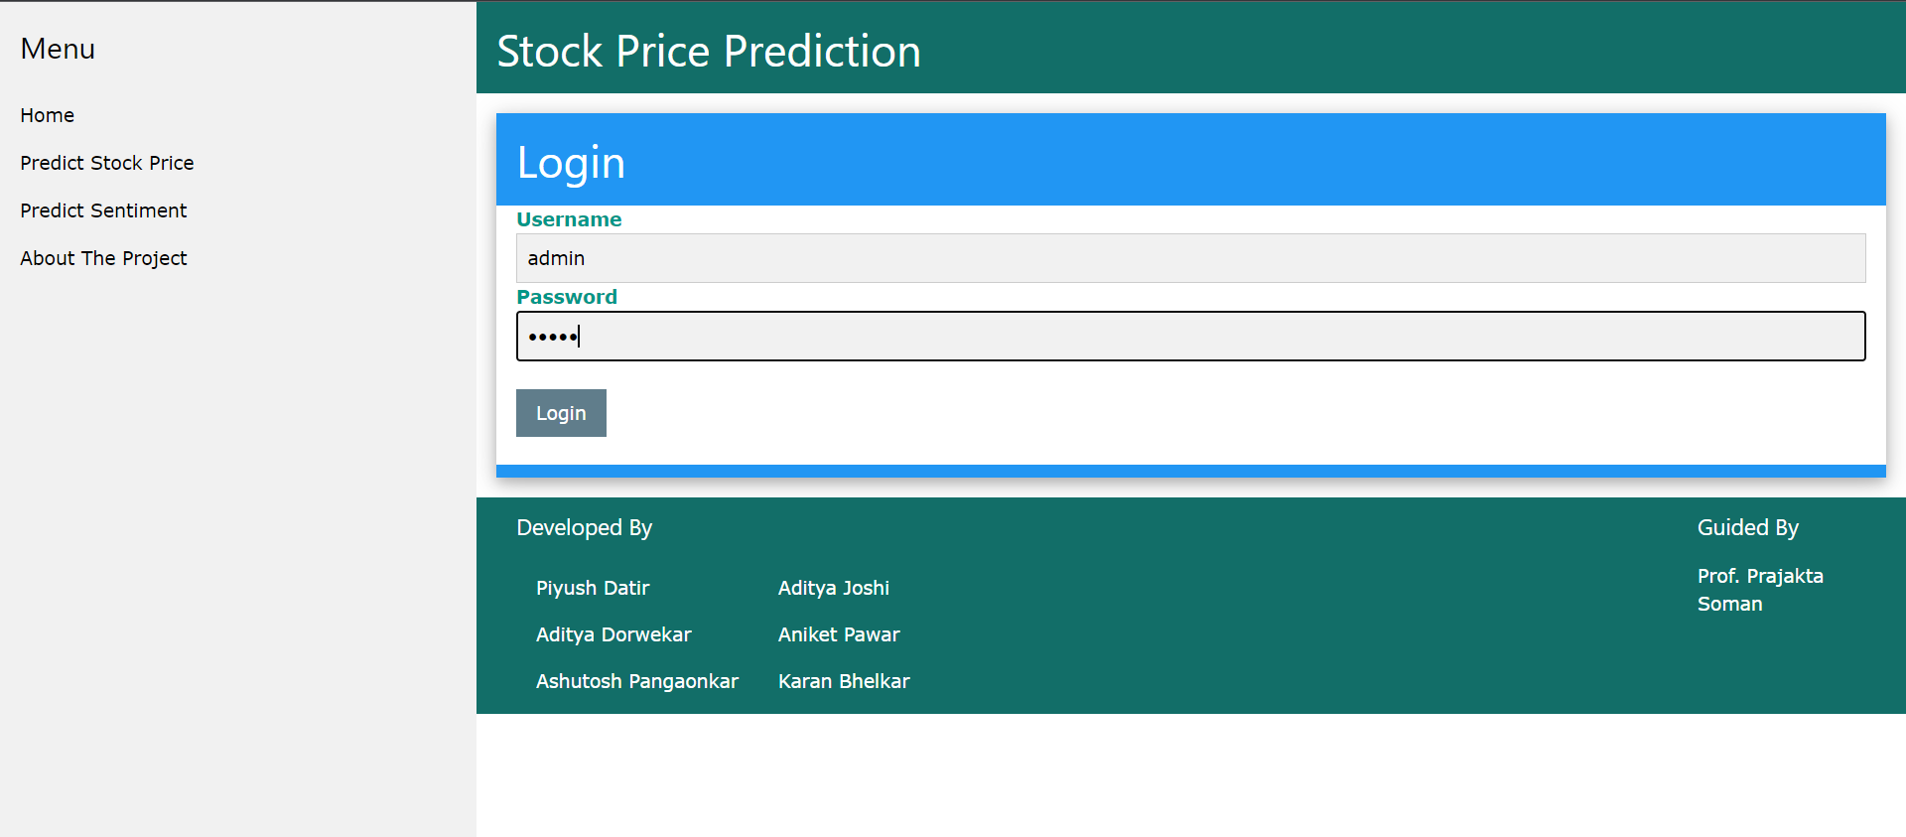

Slide 18
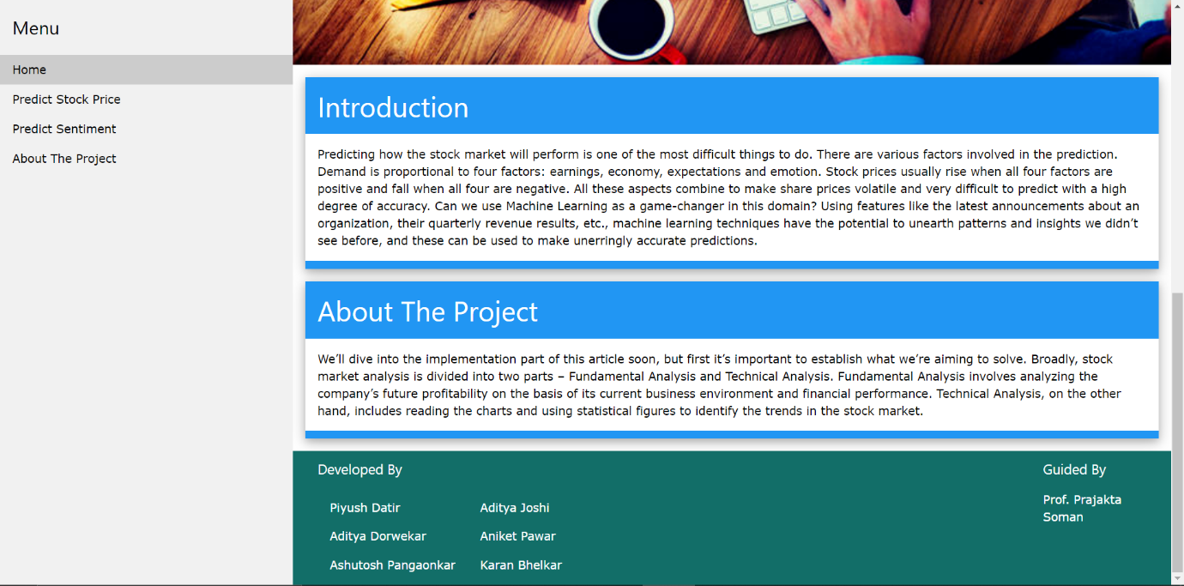

Slide 20
References
Pahwa, K., & Agarwal, N. (2019). Stock Market Analysis using Supervised Machine Learning. 2019 International Conference on Machine Learning, Big Data, Cloud and Parallel Computing.
Akba, F., Medeni, I. T., Guzel, M. S., & Askerzade, I. (2020). Assessment of Iterative Semi-Supervised Feature Selection Learning for Sentiment Analyses: Digital Currency Markets. 2020 IEEE 14th International Conference on Semantic Computing.
Sarode, S., Tolani, H. G., Kak, P., & Lifna, C. S. (2019). Stock Price Prediction Using Machine Learning Techniques. 2019 International Conference on Intelligent Sustainable Systems

Slide 21
Ravikumar, S., & Saraf, P. (2020). Prediction of Stock Prices using Machine Learning (Regression, Classification) Algorithms. 2020 International Conference for Emerging Technology
Mankar, T., Hotchandani, T., Madhwani, M., Chidrawar, A., & Lifna, C. . (2019). Stock Market Prediction based on Social Sentiments using Machine Learning. 2018 International Conference on Smart City and Emerging Technology
Kim, J., Seo, J., Lee, M., & Seok, J. (2019). Stock Price Prediction Through the Sentimental Analysis of News Articles. 2019 Eleventh International Conference on Ubiquitous and Future Network
Gupta, R., & Chen, M. (2020). Sentiment Analysis for Stock Price Prediction. 2020 IEEE Conference on Multimedia Information Processing and Retrieval

Slide 22
Thank You.

